Slide 1


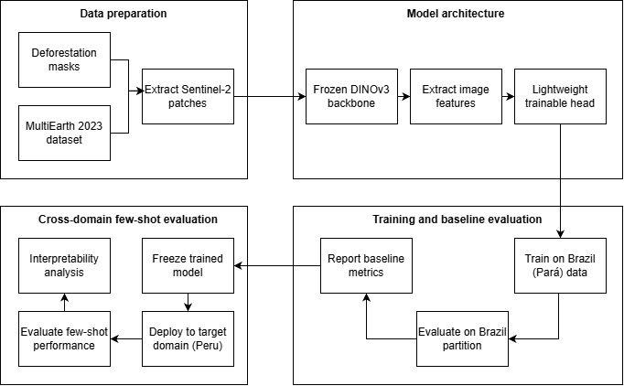
Workshop on Artificial Intelligence and Machine Learning Applications
Does self-supervised pretraining help detect deforestation in a new country? Transferring frozen DINOv3 vs. a supervised U-Net from Brazil to the Peruvian Amazon
Christian Carhuancho¹ • Jorge Chamorro¹ • Jorge Fatama¹
¹Pontificia Universidad Catolica del Peru, Lima, Peru
[AUTHOR / PROJECT / INSTITUTION LOGOS — place official logos here]
A0 PORTRAIT (841 × 1189 mm) | ENGLISH | TWO-COLUMN LAYUT | FINAL SUBMISSION: PDF | FILENAME: Poster_TitleOfWork.pdf
MOTIVATION & RESEARCH PROBLEM
OBJECTIVES / CONTRIBUTION
• What problem are you addressing?
• Why does it matter?
• What gap, challenge, or opportunity motivates the work?
• State the research objective or question clearly.
• Main objective
• Specific objective(s), if needed
• What is new, useful, or worth discussing?
Keep this section concise. The poster should invite conversation, not reproduce the abstract.
METHODOLOGY
RESULTS & DISCUSSION
Show the strongest evidence available.
[PLACE CHARTS / TABLES / QUALITATIVE RESULTS HERE]
Explain what the results mean. For work in progress, distinguish preliminary findings from planned experiments.
CONCLUSIONS
KEY REFERENCES
• Main finding(s)
• Scientific / technological relevance
• Current limitations
• Next steps
End with one clear take-home message.
[1] Author et al., Title, Venue, Year.
[2] Author et al., Title, Venue, Year.
[3] Author et al., Title, Venue, Year.
Use only the references needed to understand the contribution.
ACKNOWLEDGMENTS / FUNDING
CONTINUE THE CONVERSATION
Funding agencies, laboratories, collaborators, datasets, computing resources, or institutional support.
Optional section.
Add a QR code linking to your paper, repository, project page, demo, or professional profile.
[ QR CODE ]
Contact: author@institution.edu
BRING YOUR RESEARCH. SHARE YOUR IDEAS. JOIN THE CONVERSATION.
WAIMLAp 2026 • November 18–20, 2026 • Lima, Peru • waimlap.org

